Slide 1

Observable Patterns of Inheritance
Course: BIO 101 (Introduction to Biology)
Chapter: 10

Slide 2
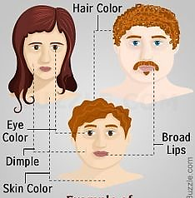
Have you ever wondered why children have similarities to both their parents?
We acquire these similar characteristics (traits) through a process called inheritance (heredity).
Inheritance occurs through transfer of genetic material from parents to their offspring.

Slide 3
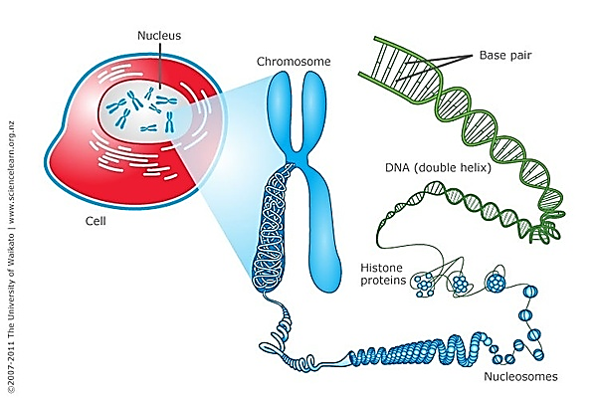
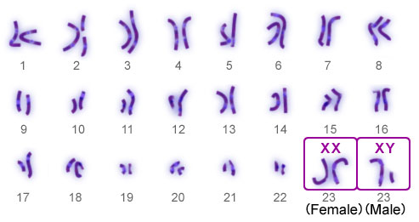
Chromosomes
Thread like structures that contain an organism’s DNA.
The DNA are coiled in proteins called histones (nucleosomes).
They are present in the nucleus of the cell (eukaryotes) or present in the cytoplasm (prokaryotes).
Different organisms have different numbers of chromosomes.
Humans have 23 pairs of chromosomes (46 in total): 1 from each pair comes from father and one from mother.

Slide 4
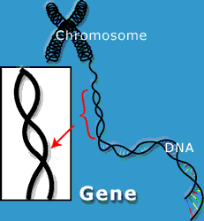
Genes
Units of information about specific traits
A sequence of DNA
Passed from parents to offspring
The complete set of DNA of an organism is called its genome.
The study of genes, genetic variation and heredity is called Genetics.

Slide 5
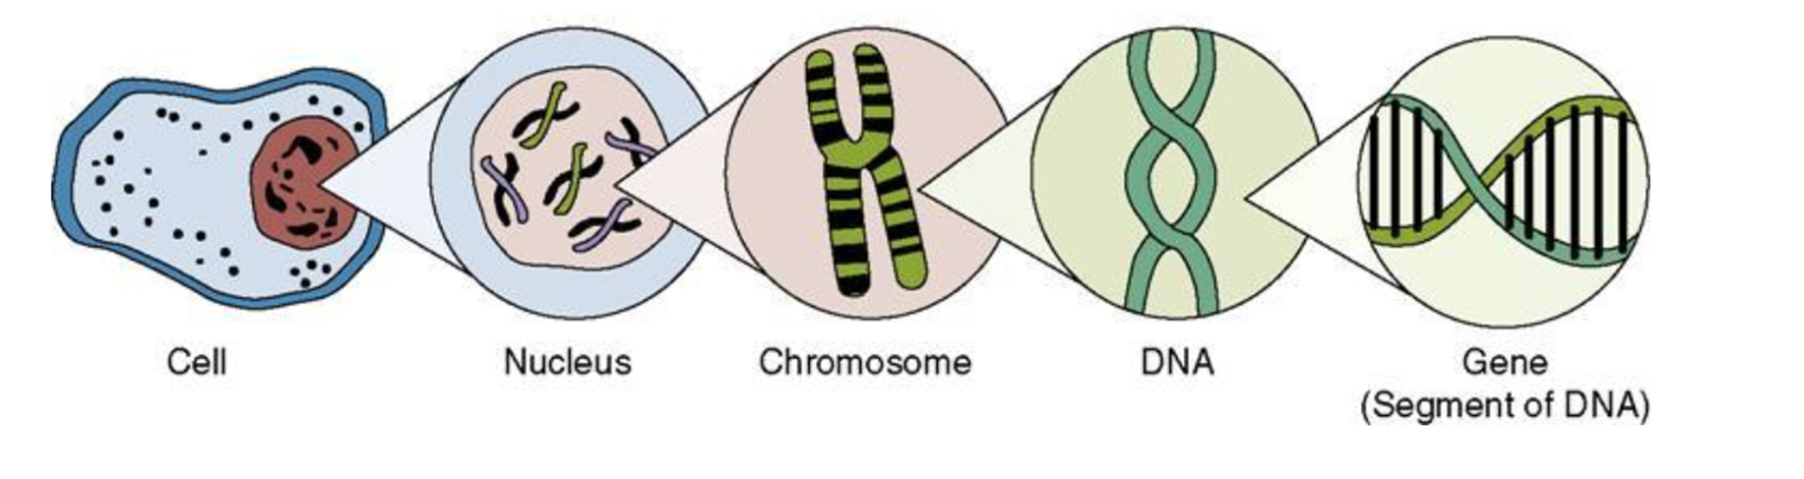

Slide 6
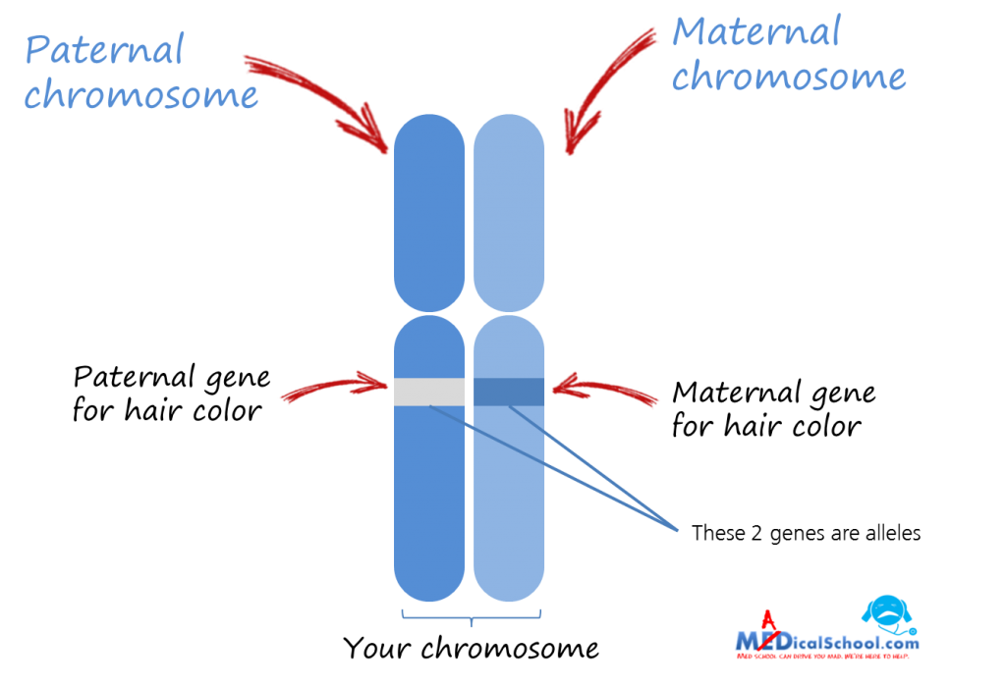
Alleles
Different molecular forms of the same gene
Arise by mutation
Each allele is passed from each parent to the offspring

Slide 7
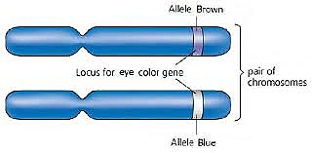
Locus
Each gene has a specific location (locus) on a chromosome
Alleles are located in the same locus of a chromosome

Slide 8
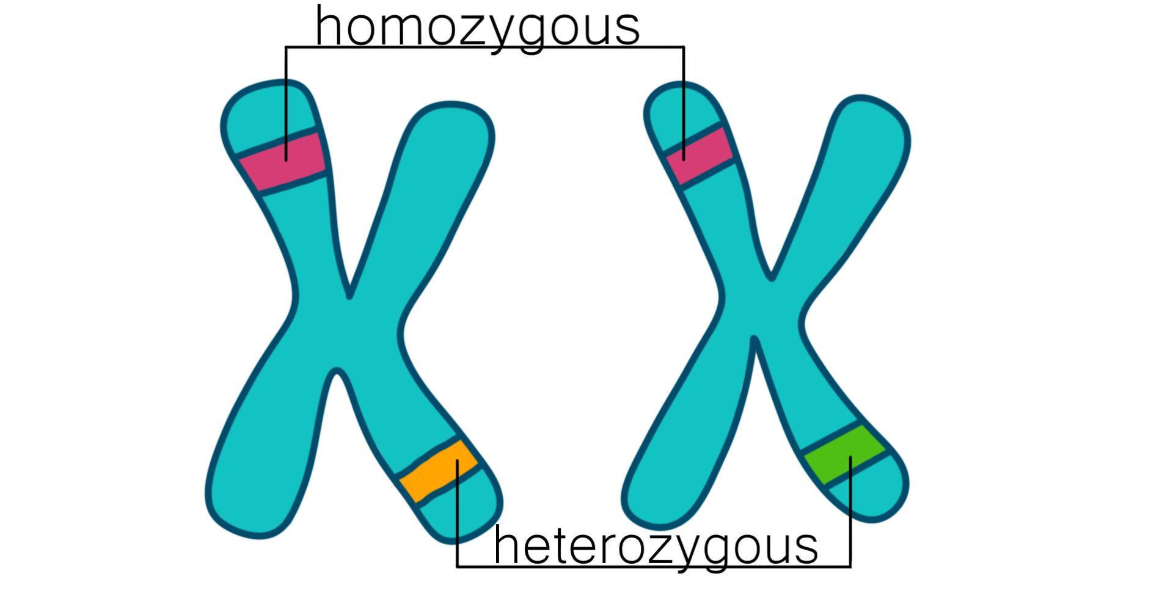
Allele Combinations
Homozygous
having two identical alleles at a locus
AA or aa
Heterozygous
having two different alleles at a locus
Aa

Slide 9
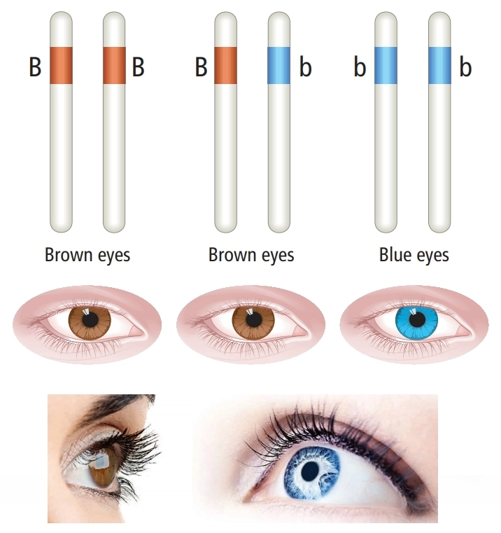
Dominant & Recessive Alleles
A dominant allele is always expressed and hence masks a recessive allele that is paired with it.
Recessive alleles are only expressed when both alleles are recessive.
Dominant alleles are written in capital letters (B) and recessive alleles are written in small letters (b).

Slide 10
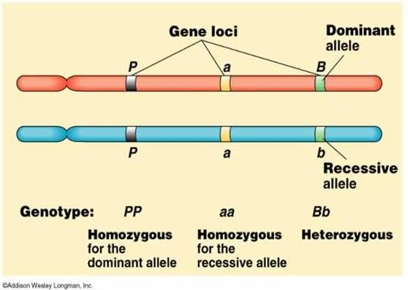
Allele | Term | Result
1 dominant + 1 dominant | Homozygous dominant (BB) | Dominant trait is expressed
1 recessive + 1 recessive | Homozygous recessive (bb) | Recessive trait is expressed
1 dominant + 1 recessive | Heterozygous (Bb) | Dominant trait is expressed

Slide 11
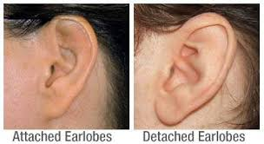
Example: Earlobe Variation
Whether a person is born with attached or detached earlobes depends on a single gene.
Dominant allele specifies detached earlobes
Recessive allele specifies attached lobes
If you have attached earlobes, you inherited two copies of the recessive allele (homozygous recessive)
If you have detached earlobes, you may have either one (heterozygous) or two copies (homozygous dominant) of the dominant allele
Recessive trait
Dominant trait

Slide 12
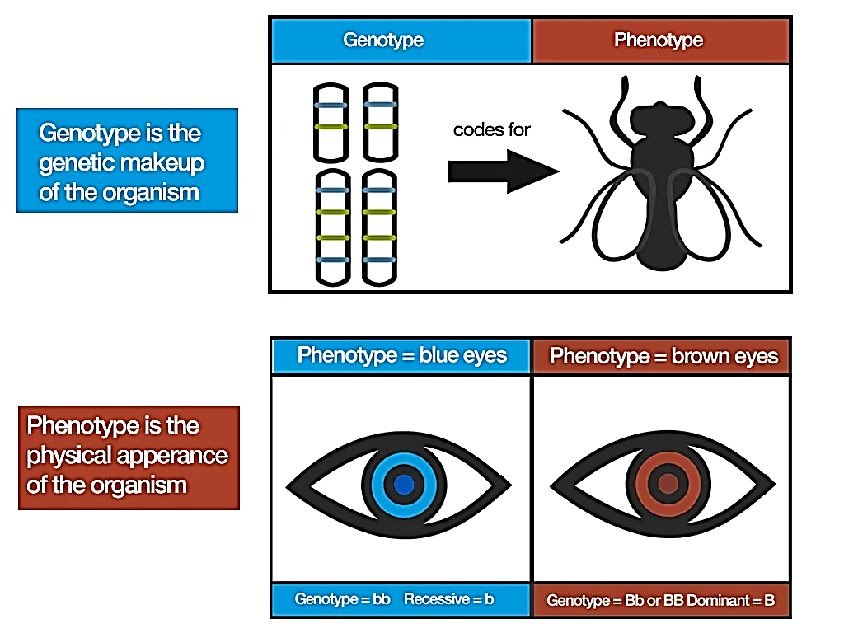
Genotype & Phenotype
Genotype refers to particular genes an individual carries
Phenotype refers to an individual’s observable traits
We cannot always determine genotype by observing phenotype: Homozygous dominant or Heterozygous?

Slide 13
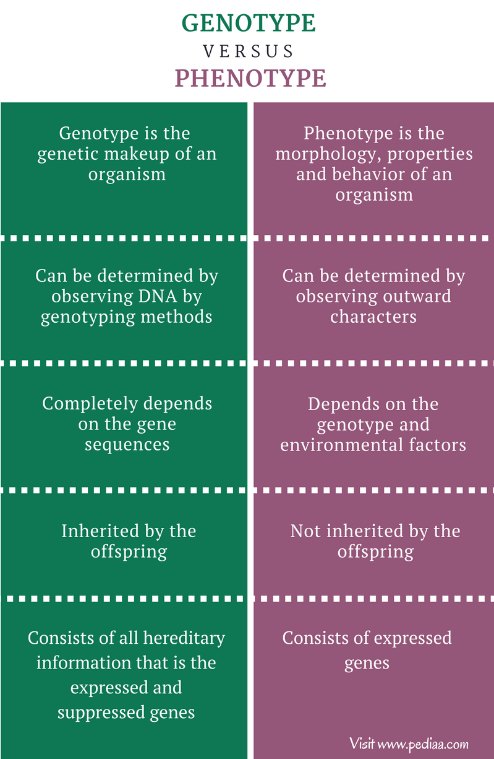
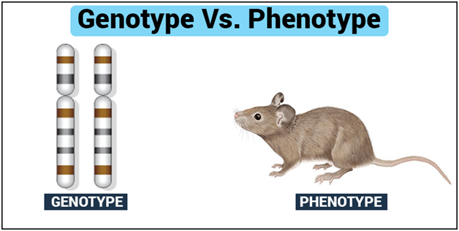

Slide 14
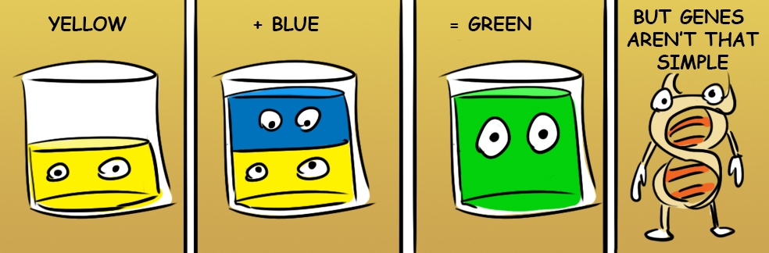
Early Ideas About Heredity
People knew that sperm and eggs transmitted information about traits
Blending theory: inheritance of traits from two parents produces offspring that are intermediate between those two parents.
Problem: would expect variation to disappear. However, variation in traits persists.

Slide 15
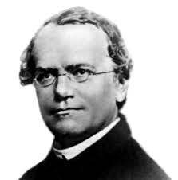
Gregor Mendel
Strong background in plant breeding and mathematics.
Using pea plants, found indirect but observable evidence of how parents transmit genes to offspring.
Particulate theory: physical traits are inherited as ‘particles’
Father of genetics!

Slide 16
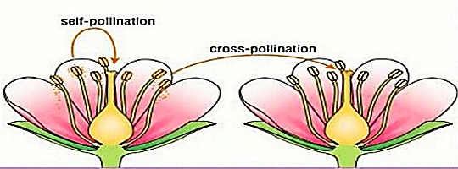
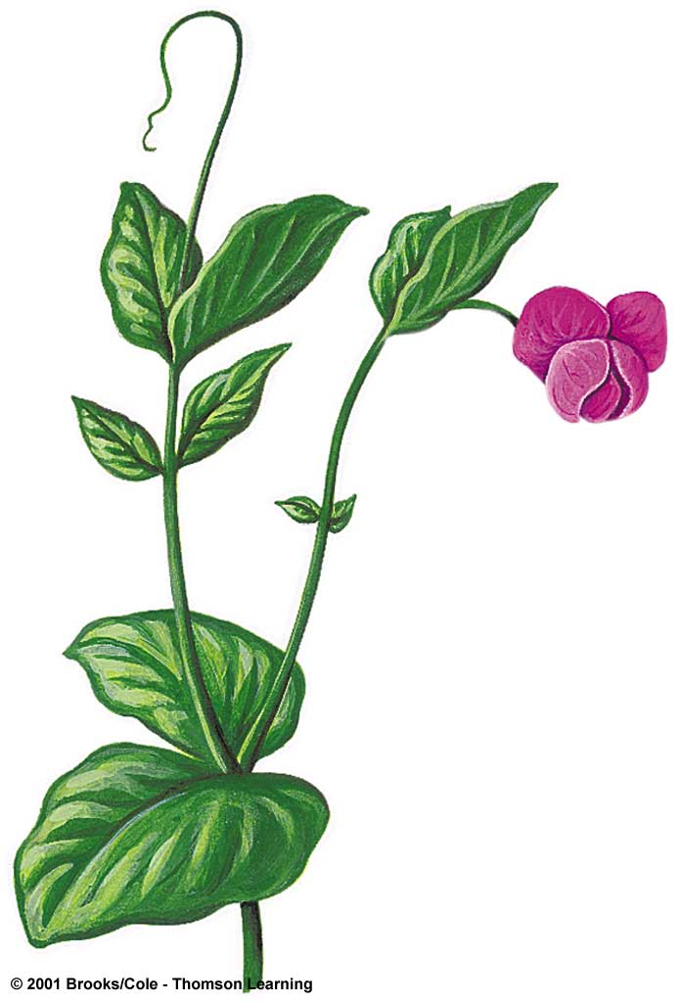
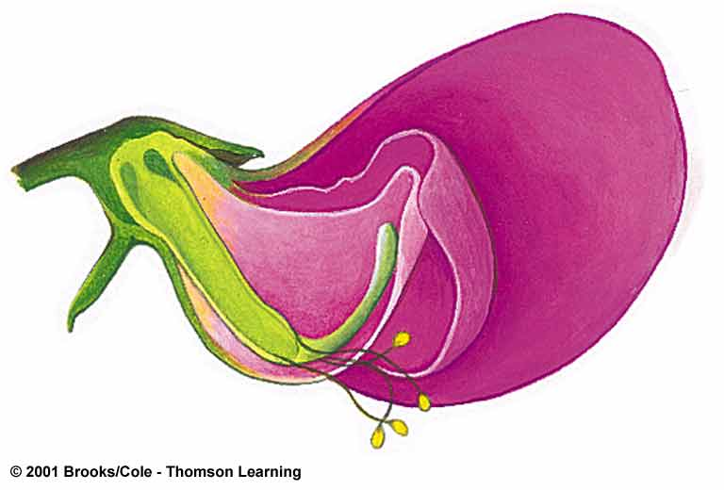
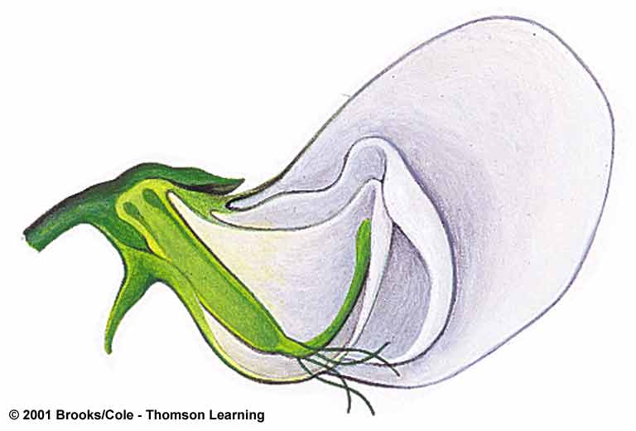
The Garden Pea Plant
Self-pollinating
True breeding (different alleles not normally introduced)
Can be experimentally cross-pollinated

Slide 17
Tracking Generations
P
Parental generation mates to produce:
First-generation offspring mate to produce:
Second-generation offspring
F₁
F₂

Slide 18
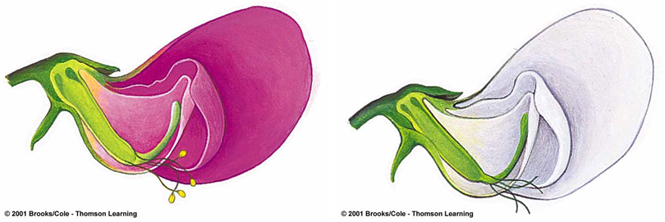
Monohybrid cross
A mix of genetics between two homozygous genotypes:
Either completely dominant or completely recessive
Mono: one
Hybrid: combination of two organisms
For garden pea plants, Mendel observed the colour of pea plants
Purple: AA
White: aa

Slide 19
Punnett Square of a Monohybrid Cross
Female gametes
a a
All dominant phenotypes
A
Aa
Aa
Male
gametes
A
Aa
Aa

Slide 20
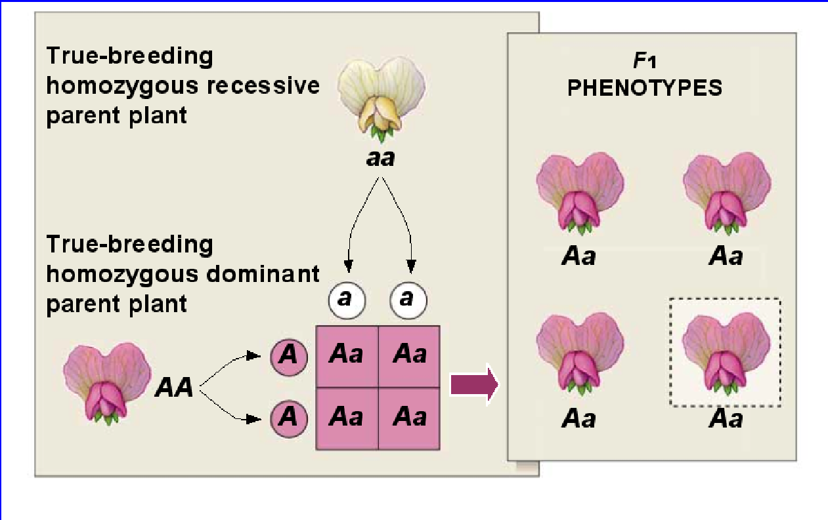
F₁ Results of One Monohybrid Cross
Result:
All offspring were heterozygous dominant (Aa)

Slide 21
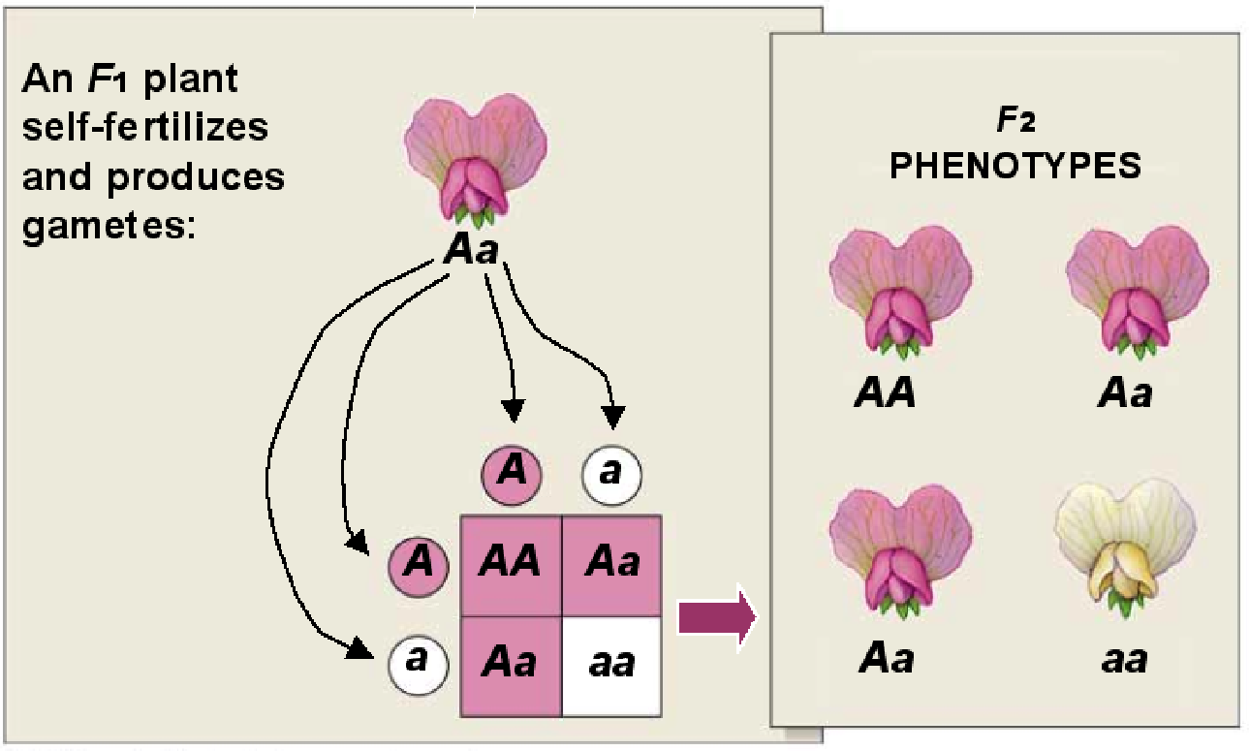
F₂ Results of Monohybrid Cross
Result:
2 offspring were heterozygous dominant (Aa)
1 offspring was homozygous dominant (AA)
1 offspring was homozygous recessive (aa)
Phenotypic ratio – 3 dominant : 1 recessive

Slide 22
Punnett Square of a Monohybrid Cross
Female gametes
A a
Dominant
phenotype can
arise 3 ways,
recessive only
one
A
AA
Aa
Male
gametes
a
Aa
aa

Slide 23
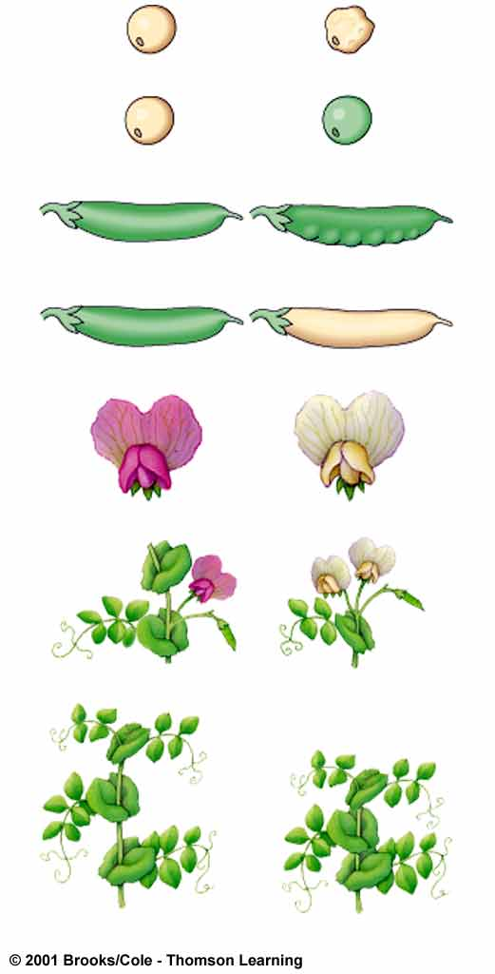
Mendel’s Monohybrid Cross Results
5,474 round
1,850 wrinkled
6,022 yellow
2,001 green
882 inflated
299 wrinkled
F₂ plants showed dominant-to-recessive ratio that averaged 3:1.
428 green
152 yellow
705 purple
224 white
651 long stem
207 at tip
787 tall
277 dwarf

Slide 24
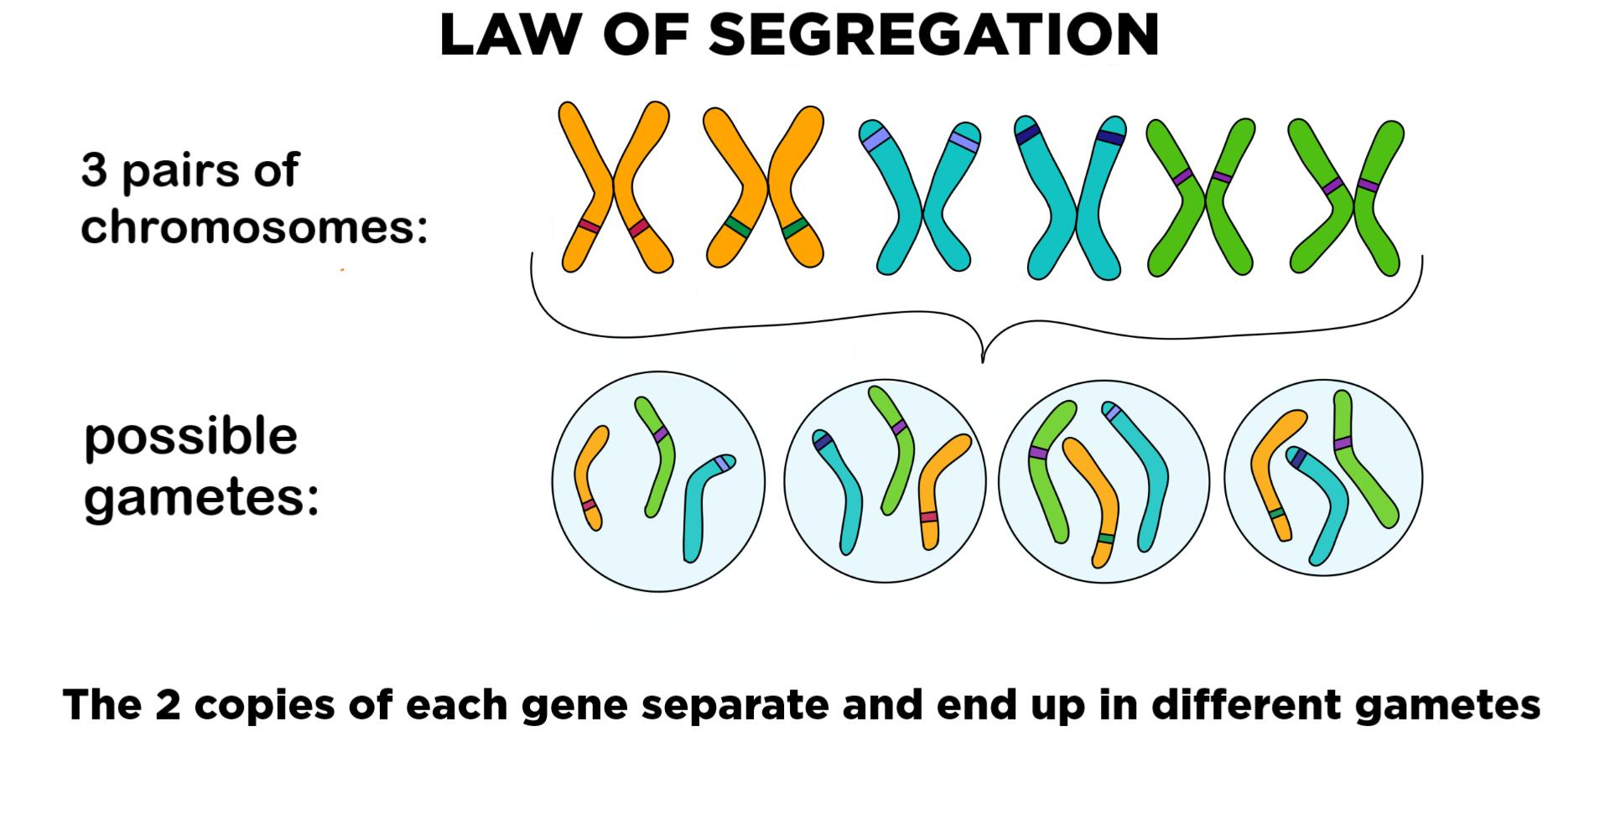
Mendel’s Theory of Segregation
An individual inherits a unit of information (allele) about a trait from each parent.
During gamete formation, the alleles segregate from each other.

Slide 25
Probability
The chance that each outcome of a given event will occur is proportional to the number of ways that event can be reached.
Can be used to determine the expected genotypes and phenotypes of offspring.
F₁ generation:
Probability of purple flowers : 1
Probability of white flowers: 0
F₂ generation:
Probability of purple flowers : 3/4
Probability of white flowers: 1/4

Slide 26
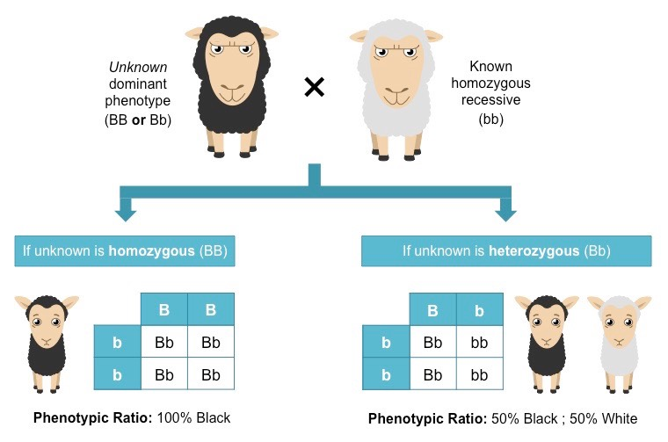
Test Cross
Individual that shows dominant phenotype is crossed with individual with recessive phenotype.
Examining offspring allows you to determine the genotype of the dominant individual.
Homozygous dominant or heterozygous?

Slide 27
Punnett Squares of Test Crosses
Homozygous recessive
Homozygous recessive
a a
a a
Heterozygous
Homozygous
dominant
A
Aa
Aa
A
Aa
Aa
a
aa
aa
A
Aa
Aa
Two phenotypes
All dominant phenotype

Slide 28
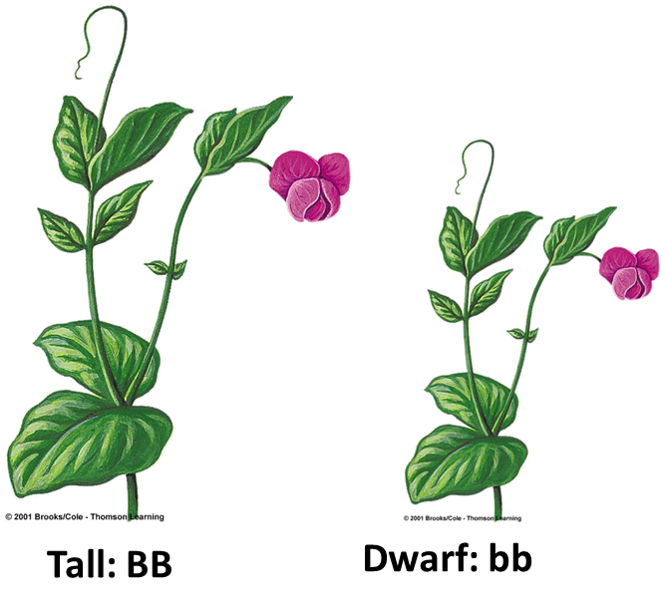
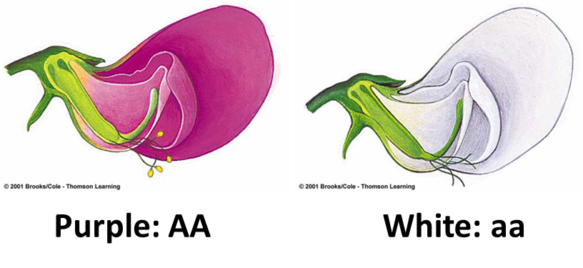
Dihybrid Cross
Experimental cross between individuals that are homozygous for different versions of two traits.
Di = two
Hybrid = combination of two organisms
+

Slide 29
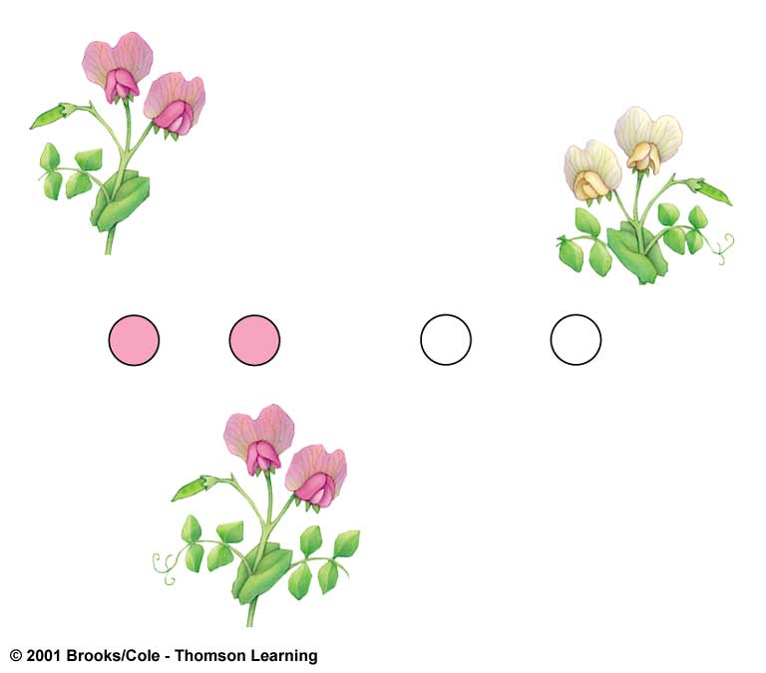
A Dihybrid Cross - F₁ Results
purple
flowers, tall
white
flowers,
dwarf
TRUE-
BREEDING
PARENTS:
AABB
x
aabb
GAMETES:
AB
AB
ab
ab
AaBb
F1 HYBRID
OFFSPRING:
All purple-flowered, tall

Slide 30
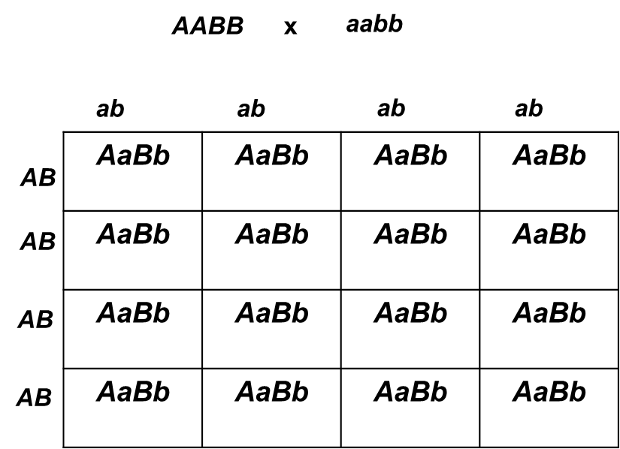
F₁ Results of Mendel’s Dihybrid Crosses
All plants displays the dominant form of both traits (Purple and tall)
We now know:
All plants inherited one allele for each trait from each parent
All plants were heterozygous (AaBb)

Slide 31
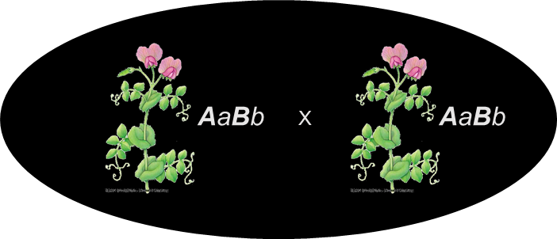
Phenotypic Ratios in F₂
If the two traits are coded for by genes on separate chromosomes, sixteen allele combinations are possible:
1/4
1/4
1/4
1/4
AB
Ab
aB
ab
1/4
Four Phenotypes:
Tall, purple-flowered (9/16)
Tall, white-flowered (3/16)
Dwarf, purple-flowered (3/16)
Dwarf, white-flowered (1/16)
Phenotypic ratio: 9:3:3:1
AB
1/16
1/16
1/16
1/16
AABB
AABb
AaBB
AaBb
1/4
1/16
1/16
1/16
1/16
Ab
AABb
AAbb
AaBb
Aabb
1/4
1/16
1/16
1/16
1/16
aB
AaBB
AaBb
aaBB
aaBb
1/4
1/16
1/16
1/16
1/16
ab
AaBb
Aabb
aaBb
aabb

Slide 32
Mendel’s Law of Independent Assortment
Mendel concluded that the two “units” for the first trait were to be assorted into gametes independently of the two “units” for the other trait.
Members of each pair of homologous chromosomes are sorted into gametes at random during meiosis.

Slide 33
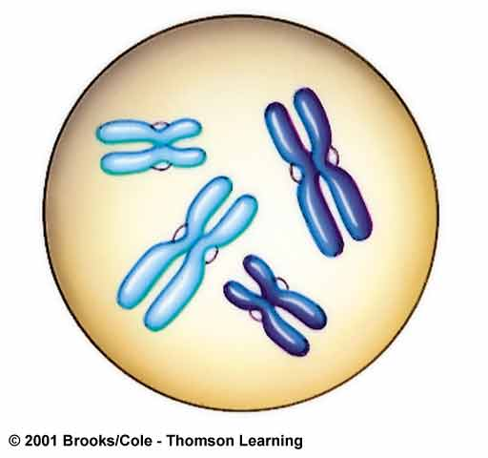
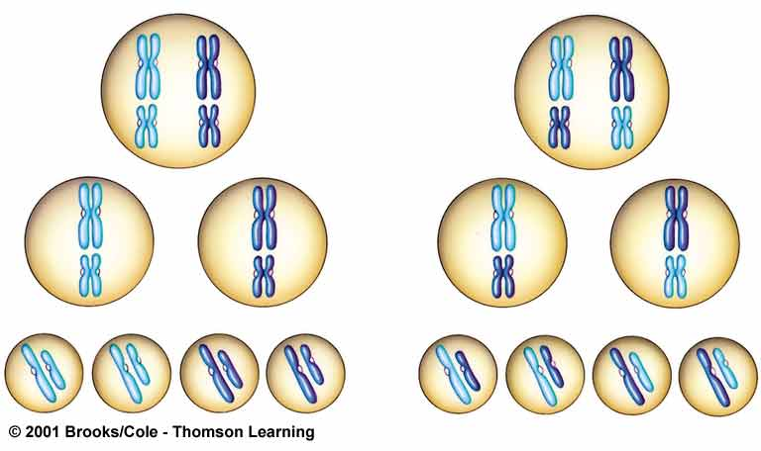
Independent Assortment
OR
Metaphase I
A
A
a
a
A
A
a
a
B
B
b
b
b
b
B
B
Metaphase II:
A
A
a
a
A
A
a
a
B
B
b
b
b
b
B
B
Gametes:
B
B
b
b
b
b
B
B
A
A
a
a
A
A
a
a
1/4 AB
1/4 ab
1/4 Ab
1/4 aB

Slide 34
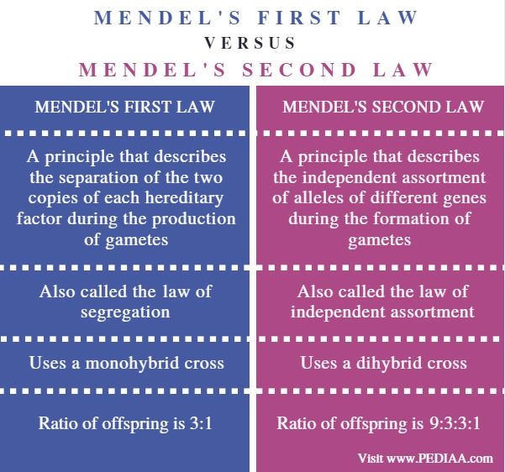

Slide 35
Tremendous Variation
Number of genotypes possible in offspring as a result of independent assortment and hybrid crossing is:
3^{n}
(n is the number of gene loci at which the parents differ)

Slide 36
Impact of Mendel’s Work
Mendel presented his results in 1865
Paper received little notice
Mendel discontinued his experiments in 1871
Paper rediscovered in 1900 and finally appreciated

Slide 37
Dominance Relations
Dominance
Complete dominance
Incomplete dominance
Codominance

Slide 38
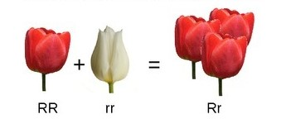
Complete dominance
Dominance in heterozygous condition where the dominant allele completely masks the effects of the recessive allele.

Slide 39
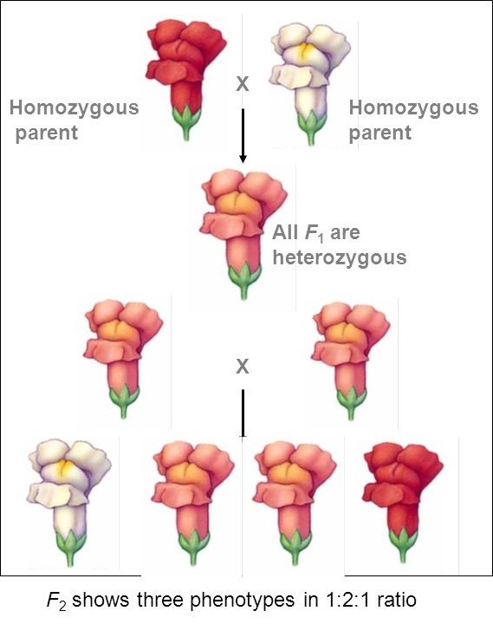
Incomplete dominance
Flower colour in Snapdragons
Dominant allele does not completely mask the effect of the recessive allele.
Heterozygous phenotype is somewhere between that of two homozygotes.
Blend of both traits

Slide 40
Incomplete dominance (cont.)
Red flowers - two alleles allow them to make a red pigment
White flowers - two mutant alleles; can’t make red pigment
Pink flowers have one normal and one mutant allele; make a smaller amount of red pigment

Slide 41
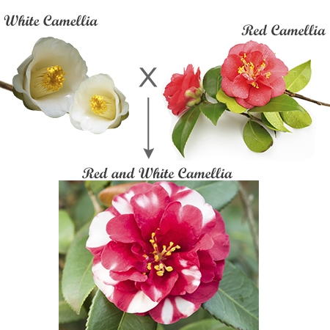
Codominance
Both alleles of a particular trait are fully expressed.
Non-identical alleles specify two phenotypes that are both expressed in heterozygotes.
Offspring has a phenotype that shows combination of both traits.

Slide 42
Genetics of ABO Blood Types: Three Alleles
Gene that controls ABO type codes for enzyme that dictates structure of a glycolipid on red blood cells.
Two alleles (I^{A} and I^{B}) are codominant when paired
Third allele (i) is recessive to others

Slide 43
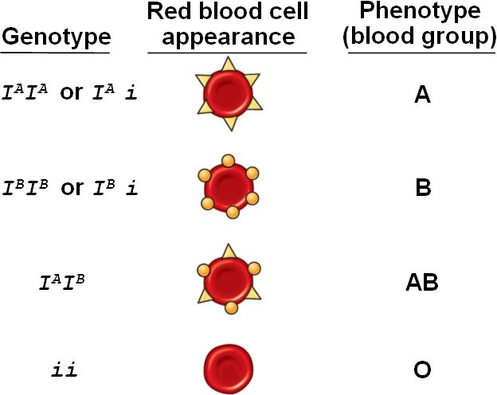
ABO Blood Type: Allele Combinations

Slide 44
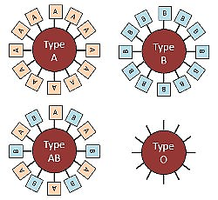
ABO Blood Type: Glycolipids on Red Cells
Type A - Glycolipid A on cell surface
Type B - Glycolipid B on cell surface
Type AB - Both Glycolipids A & B
Type O - Neither Glycolipids A nor B

Slide 45
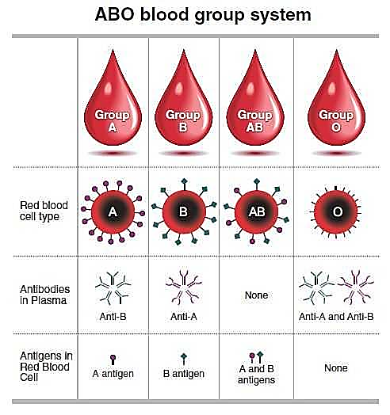
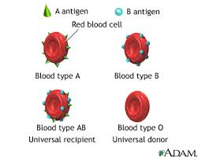
ABO and Transfusions
Recipient’s immune system will attack blood cells that have an unfamiliar glycolipid on surface.
Type O is universal donor because it has neither type A nor type B glycolipid.
Type AB is the universal recipient because it has antigens for both A and B glycolipid.

Slide 46
THANK YOU!

